Slide 1
PoseCNN: A Convolutional Neural Network for 6D
Object Pose Estimation in Cluttered Scenes
XIANG, Yu, et al. Posecnn: A convolutional neural network for 6d object pose estimation in cluttered scenes. arXiv preprint arXiv:1711.00199, 2017.
Reporter : WEI-HAN CHEN
SHU-HUAN DENG

Slide 2
Outline
Introduction
Related Work
Proposed Method (PoseCNN)
Experimental Results
Conclusions

Slide 3
Introduction
PoseCNN, a new Convolutional Neural Network for 6D object pose estimation
Recognizing objects and estimating their poses in 3D location and orientation, and use ICP to refine the pose.
Contributions：
Propose a novel convolutional neural network for 6D object pose estimation named PoseCNN. The network achieves end-to-end 6D pose estimation and is very robust to occlusions between objects.
A novel loss function ShapeMatch-Loss, that enables PoseCNN to handle symmetric objects
Contribute a large scale RGB-D video dataset for 6D object pose estimation, where we provide 6D pose annotations for 21 YCB objects.
Notes:
They have different 3D shapes, and their appearances on images are affected by lighting conditions, clutter in the scene and occlusions between objects
1. This paper is published at 2017, but before 2017 , the problem of 6D object pose estimation is tackled by matching feature points between 3D models and Images. But these methods require that there are rich textures on the objects in order to detect feature points for matching. As a result, they are unable to handle
texture-less objects. With the emergence of depth cameras, several methods have been proposed for recognizing textureless objects using RGB-D data
2. (先說)symmetries are typically ignored during network training before 2017

Slide 4
Related Work
Notes:
Next, is our related work,
6D object pose estimation methods can be roughly classified into two cases, template-based methods and feature-based methods.
Let us first go into template-based methods.

Slide 5
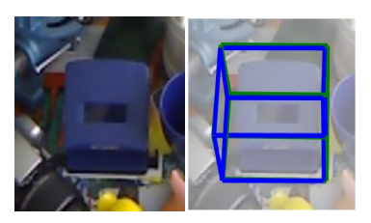
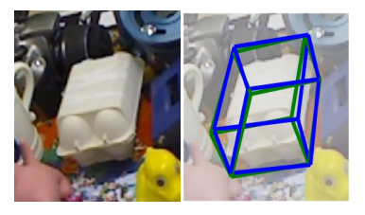
Related Work - template-based methods
At each location, a similarity score is computed, and the best match is obtained by comparing these similarity scores.
Good at detecting texture-less objects.
Cannot handle occlusions between objects very well.
Bugra Tekin, Sudipta N Sinha, and Pascal Fua. Real-time seamless single shot 6D object pose prediction. In IEEE Conference on Computer Vision and Pattern Recognition (CVPR), 2018.
Notes:
In template-based methods, a rigid template is constructed and used to scan different locations in the input image.
At each location, a similarity score is computed, and the best match is obtained by comparing these similarity scores.
In many research , 2D object detection methods are used as template matching and augmented for 6D pose estimation, especially with deep learning-based object detectors.
Template based methods are useful in detecting texture-less objects, just like the picture.
As you can see, although the object has very little texture, the 6D object pose can still be predicted accurately.
However, they cannot handle occlusions between objects very well, since the template will have low similarity score if the object is occluded.

Slide 6
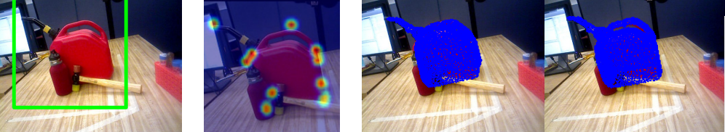
Related Work - feature-based methods
Local features are extracted from either points of interest or every pixel in the image and matched to features on the 3D.
Good at handle occlusions between objects.
Require sufficient textures on the objects in order to compute the local features.
Georgios Pavlakos, Xiaowei Zhou, Aaron Chan, Konstantinos G Derpanis, and Kostas Daniilidis. 6-DOF object pose from semantic keypoints. IEEE International Conference on Robotics and Automation (ICRA), 2017.
Notes:
Next is the feature-based methods.
In feature-based methods, local features are extracted from either points of interest or every pixel in the image and matched to features on the 3D models to establish the 2D to 3D correspondences.
By doing so, the 6D poses can be recovered.
Feature-based methods are able to handle occlusions between objects.
As you can see in the ppt, the obscured object can be predicted accurately.
However, they require sufficient textures on the objects in order to compute the local features.
According to the mention above , there are some drawbacks in existing researches.
As a result, the author combined the advantages of both template-based methods and feature-based methods in a deep learning framework.
Let’s see how he did it.

Slide 7
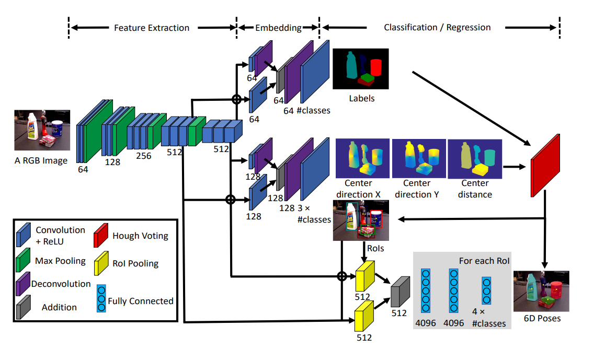
PoseCNN
Notes:
As you know, given an input image, the task of 6D object pose estimation is to estimate the rigid transformation from the object coordinate system to the camera coordinate system.
As a result , the author proposed a convolutional neural network architecture that internally decouples the estimation of rotation R and translation T.
The network in ppt contains two stages.
The first stage consists of 13 convolutional layers and 4 maxpooling layers, which extract feature maps with different resolutions from the input image.
This stage is the backbone of the network since the extracted features are shared across all the tasks performed by the network.
The second stage consists of an embedding step,
that embeds the high-dimensional feature maps generated by the first stage into low-dimensional, task-specific features.
After that, the network performs three different tasks that lead to the 6D pose estimation , they are semantic labeling, 3D translation estimation, and 3D rotation regression.
Let’s first go into Semantic Labeling.

Slide 8
Semantic Labeling
Notes:
In order to detect objects in images, the author resorted to semantic labeling, where the network classifies each image pixel into an object class.
Semantic labeling provides richer information about the objects and handles occlusions better.
The embedding step of the semantic labeling branch takes two feature maps generated by the feature extraction stage as inputs.
After lots of convolution and Deconvolution, the output of this layer has n channels which n is the number of the semantic classes.
In training, a softmax cross entropy loss is applied to train the semantic labeling branch.
While in testing, a softmax function is used to compute the class probabilities of the pixels.

Slide 9
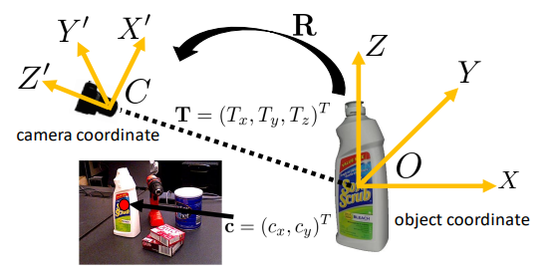
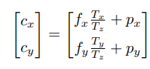
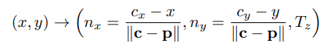
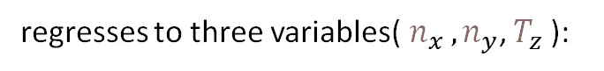
3D Translation Estimation
Projection equation:
regresses to three variables($n_{x },n_{y}$, $T_{z}$):
Notes:
Next is 3D Translation Estimation
As you can see in the picture, C is the camera coordinate, O is the object coordinate, and T is the coordinate of the object origin in the camera coordinate system.
The author estimated the 3D translation by localizing the 2D object center in the image and estimating object distance from the camera.
To see, suppose the projection of T on the image is cx and cy .
If the network can localize c in the image and estimate the depth Tz,
then we can recover Tx and Ty according to the projection equation assuming a pinhole camera.
The fx and fy denote the focal lengths of the camera, and px py is the principal point.
In order to localize the 2D object center, the author designed their network to regress to the center direction for each pixel in the image.
P is the pixel coordinates on the image, and according to the equation at the ppt, it regresses to three variables , nx , ny and tz.
The normalization to unit vector here make it become scale-invariant and easier to be trained.

Slide 10
3D Translation Estimation
Notes:
The center regression branch architecture is similar to the semantic labeling branch.
Expect embedding features into higher dimensional space since this branch needs to regress to three variables for each object class.
After lots of convolution and Deconvolution, the output of this layer has 3*n channels which n is the number of the object classes.
In training, a smoothed L1 loss function is applied for regression

Slide 11
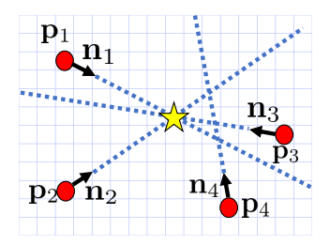
3D Translation Estimation - Hough voting
It first computes the voting score for every location in the image.
Each pixel in the object class adds votes for image locations along the ray predicted from the network.
Depth prediction of the center (Tz) is simply computed as the mean of the depths predicted by the inliers.
Notes:
What’s more,
In order to find the 2D object center c, a Hough voting layer is designed and integrated into the network.
The Hough voting layer takes the results of the pixel-wise semantic labeling and the center regression as inputs.
For each object class, it first computes the voting score for every location in the image.
The voting score indicates how likely the corresponding image location is the center of an object in the class.
Specifically, each pixel in the object class adds votes for image locations along the ray predicted from the network.
After processing all the pixels in the object class, we obtain the voting scores for all the image locations.
Then, the object center is selected as the location with the maximum score.
After generating a set of object centers, we consider the pixels that vote for an object center to be the inliers of the center.
Then the depth prediction of the center Tz is simply computed as the mean of the depths predicted by the inliers.
Finally, using this equation, we can estimate the 3D translation T.

Slide 12
3D Rotation Regression
Notes:
Next is the 3D Rotation Regression.
The lowest part of the picture shows the 3D rotation regression branch.
Using the object bounding boxes predicted from the Hough voting layer, the author utilized two RoI pooling layers to “crop and pool” the visual features generated by the first stage of the network.
The final layer has dimension 4 * n with n the number of object classes.
For each class, the last layer outputs a 3D rotation represented by a quaternion.

Slide 13
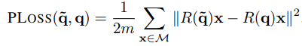
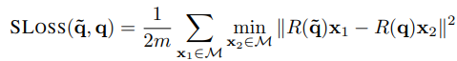
3D Rotation Regression
PossLoss:
There is a minimum when the estimated orientation is identical to the ground truth orientation.
Bad use on symmetric objects.
ShapeMatch-Loss:
It measures the offset between each point on the estimated model orientation and the closest point on the ground truth model.
There is a minimum when the two 3D models match each other.
Notes:
To train the quaternion regression, the author proposed two loss functions,
The first loss is called PoseLoss (a.k.a PLOSS).
Now let’s see the left equation,
It operates in the 3D model space and measures the average squared distance between points on the correct model pose and their corresponding points on the model using the estimated orientation.
This loss has its unique minimum when the estimated orientation is identical to the ground truth orientation.
Unfortunately, PLOSS does not handle symmetric objects appropriately, since a symmetric object can have multiple correct 3D rotations.
As a result, the author introduced ShapeMatch-Loss (a.k.a SLOSS), a loss function that does not require the specification of symmetries.
Just like iCP, this loss measures the offset between each point on the estimated model orientation and the closest point on the ground truth model.
SLOSS is minimized when the two 3D models match each other.
In this way, the SLOSS will not penalize rotations that are equivalent with respect to the 3D shape symmetry of the object.

Slide 14
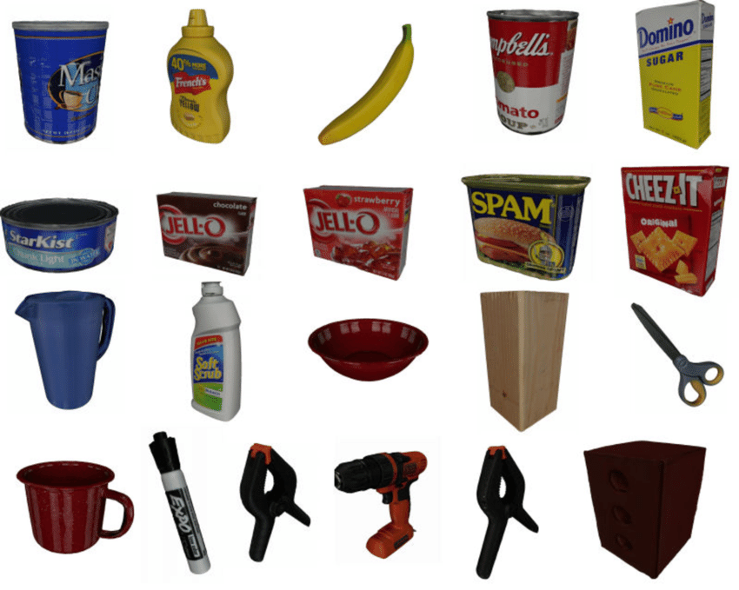
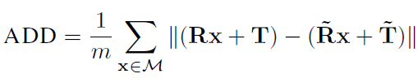
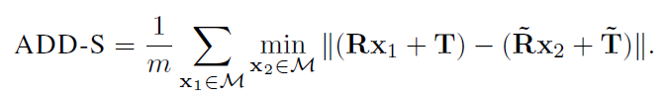
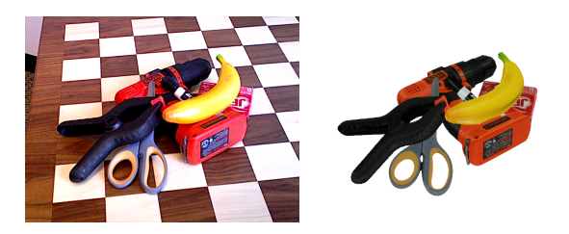
Experiments
Datasets：
YCB-Video dataset, we use 80 videos for training, and test on 2,949 key frames extracted from the rest 12 test videos.
OccludedLINEMOD dataset, There are significant occlusions between objects in this video sequence, which makes this dataset challenging
Evaluation Metrics：
Notes:
Our design of the loss function for rotation regression is motivated by these two evaluation metrics, average distance (ADD) metric, Given the ground truth rotation R and translation T and the estimated rotation ~R and translation ~T, the average distance computes the mean of the pairwise distances between the 3D model points transformed according to the ground truth pose and the estimated pose:
M denotes the set of 3D model points and m is the number of points. The 6D pose is considered to be correct if the average distance is smaller than a predefined threshold. In the Occluded LINEMOD dataset, the threshold is set to 10% of the 3D model diameter. For symmetric objects such as the Eggbox and Glue, the matching of two points is ambiguous for some views. Therefore, the average distance is computed using the closest point distance:
. Using a fixed threshold (沒有用固定的)in computing pose accuracy cannot reveal how a method performs on these incorrect poses with respect to that threshold. Therefore, we vary the distance threshold in evaluation.
In this case, we can plot an accuracy-threshold curve(下面幾張ppt會有), and compute the area under the curve for pose evaluation.

Slide 15
Experimental Results
Implement Details：
TensorFlow library
Hough voting layer is implemented on GPU
Baselines：
Compare with 3D object coordinate regression network
Pose refinement：
Use point-plane ICP to refine the 6D pose
Notes:
Implement Details：
((((((((((PoseCNN is implemented using the TensorFlow library [1]. The Hough voting layer is implemented on GPU as in [31]. In training, the parameters of the first 13 convolutional layers in the feature extraction stage and the first two FC layers in the 3D rotation regression branch are initialized with the VGG16 network [27] trained on ImageNet [9]. No gradient is backpropagated via the Hough voting layer. Stochastic Gradient Descent (SGD) with momentum is used for training.))))))))))))))
Baseline:
. Since the state of the-art 6D pose estimation methods before 2017, mostly rely on regressing image pixels to 3D object coordinates
In this network, instead of regressing to center direction and depth as in Fig. 2, we regress each pixel to its 3D coordinate in the object coordinate
system. We can use the same architecture since each pixel still regresses to three variables for each class. Then we remove the 3D rotation regression branch. Using the semantic labeling results and 3D object coordinate regression results, the 6D pose is recovered using the pre-emptive RANSAC .
Pose refinement(must have the depth)
((((((We render a predicted point cloud given the 3D model and an estimated pose, and assume that each observed depth value is associated with the predicted depth value at the same pixel location. The residual for each pixel is then the smallest distance from the observed point in 3D to the plane defined by the rendered point in 3D and its normal. Points with residuals above a specified threshold are rejected and the remaining residuals are minimized using gradient descent. Semantic labels from the network are used to crop the observed points from the depth image. Since
ICP is not robust to local minimums, we refinement multiple poses by perturbing the estimated pose from the network, and
then select the best refined pose using the alignment metric proposed in .))))))))))))))

Slide 16
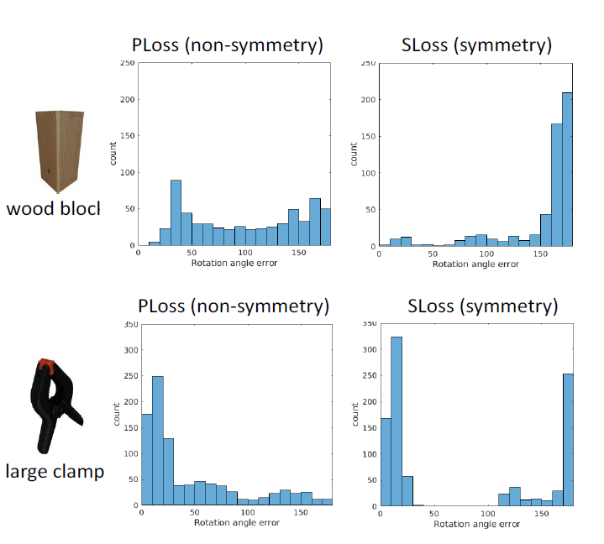
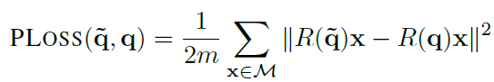
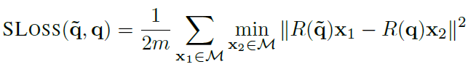
Experimental Results
Analysis on the Rotation Regress Losses
Notes:
The rotation errors of the PLOSS for the wood block and the large clamp span from 0 degree to 180 degree. The two histograms indicate that the network is confused by the symmetric objects.
(((((((((就像先前所說的, PLOSS does not handle symmetric objects appropriately, since a symmetric object can have multiple correct 3D rotations. Using such a
loss function on symmetric objects unnecessarily penalizes the network for regressing to one of the alternative 3D rotations, thereby giving possibly inconsistent(不符的) training signals.))))))))))))))))))
While the histograms of the SLOSS concentrate on the 180 degree error for the wood block and 0 degree and 180 degree for the large clamp, since they are symmetric with respect to 180 degree rotation around their coordinate axes.

Slide 17
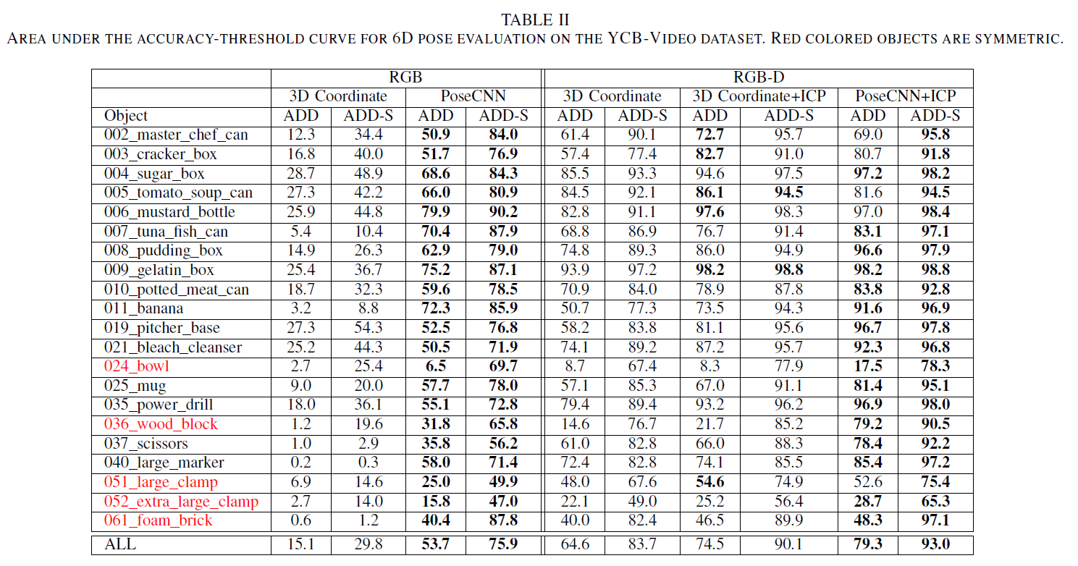
Experimental Results
Results on the YCB-Video Dataset
Notes:
***********We show the area under the accuracy-threshold curve using both the ADD metric and the ADD-S metric, where we vary the threshold for the average distance and then compute the pose accuracy. The maximum threshold is set to 10cm(ADD最大就是10cm就不算成功).********
左半部分(center localization)
By only using color images, our network significantly outperforms the 3D coordinate regression net work. Because when there are errors in the 3D coordinate regression results, the estimated 6D pose can drift far away from the ground truth pose. While in our network, the center localization helps to constrain the 3D translation estimation even if the object is occluded
右半部分(ICP)
Refining the poses with ICP significantly improves the performance. PoseCNN with ICP achieves superior performance compared to the 3D coordinate regression network when using depth images. The initial pose in ICP is critical for convergence. PoseCNN provides better initial 6D poses for ICP refinement(posecnn會比3d coordinate還要快地找到初始的位置，以便之後拿icp做refinement的時候處理的必較好)
3. We can see that some objects are more difficult to handle such as the tuna fish can that is small and with less texture. The 3D coordinate regression network cannot handle symmetric objects very well such as the bowl.
As we can see by using our ShapeMatch-Loss for training, PoseCNN is able to correctly estimate the 6D pose of the symmetric objects.

Slide 18
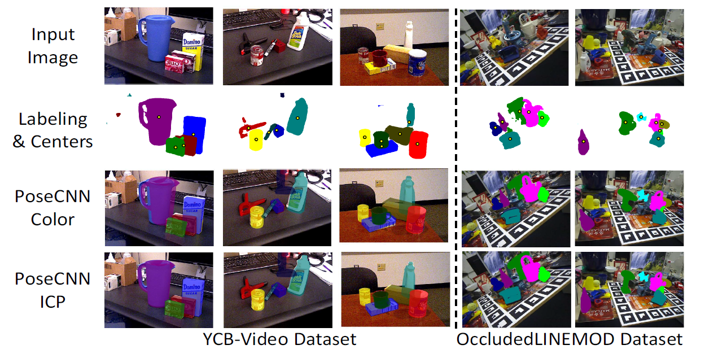
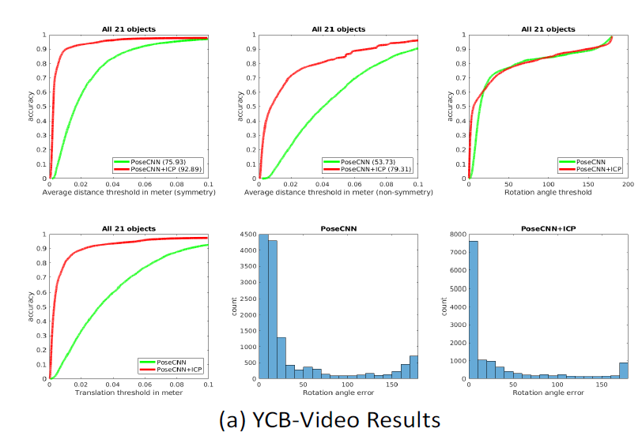
Experimental Results
Results on the YCB-Video Dataset
Notes:
We show the area under the accuracy-threshold curve using both the ADD(top middle) metric and the ADD-S(top left) metric
displays some 6D pose estimation results on the YCB-Video dataset. We can see that the center prediction is quite accurate even if the center is occluded by another object. Our network with color only is already able to provide good 6D pose estimation. With ICP refinement, the accuracy of the 6D pose is further improved.

Slide 19
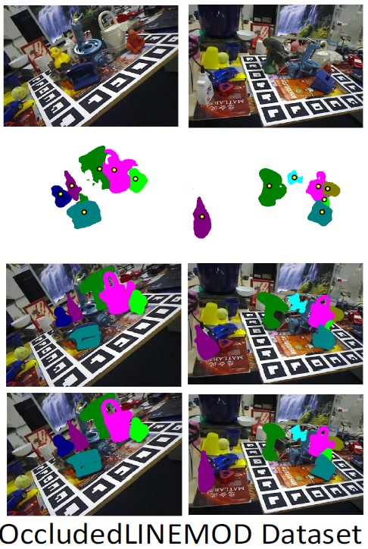
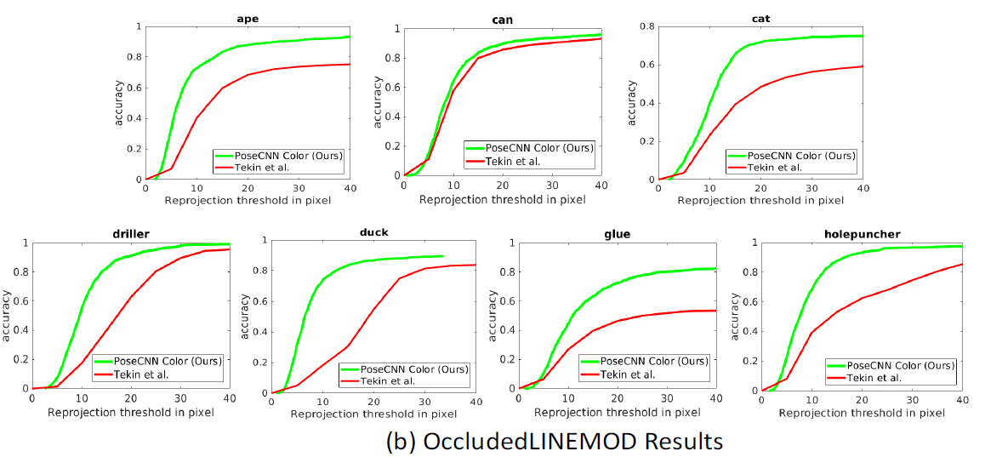
Experimental Results
Results on the OccludedLINEMOD Dataset
Notes:
The OccludedLINEMOD dataset is challenging due to significant occlusions between objects. We first conduct experiments using color images only. Fig. 8(b) shows the accuracy threshold curves with reprojection error for 7 objects in the dataset, where we compare PoseCNN the current state-of-the-art by using color images as input. These results show that PoseCNN is able to correctly localize the target object even under severe occlusions.

Slide 20
Conclusion
PoseCNN decouples the estimation of 3D rotation and 3D translation.
The 3D translation is estimated by localizing the object center and predicting the center distance.
The 3D rotation is predicted by regressing to a quaternion representation.
This opens the path to using cameras with resolution and field of view that goes far beyond currently used depth camera systems.
Notes:
The last is the conclusion,
The author proposed a new framework called PoseCNN, which decouples the estimation of 3D rotation and 3D translation.
The 3D translation is estimated by localizing the object center and predicting the center distance.
And the 3D rotation is predicted by regressing to a quaternion representation.
This opens the path to using cameras with resolution and field of view that goes far beyond currently used depth camera systems.

Slide 21
Thank you for listening!!
Notes:
That brings me to the end of our presentation, thanks for your attention

Slide 22

Notes:
The input image first goes through a cascaded convolutional neural network for feature extraction.
And this part adopts the VGG structure,which is a structure that extract feature maps with different resolution from input.
Then, the network is divided into three task branches, corresponding to semantic segmentation, translation matrix prediction and rotation matrix prediction.
The semantic segmentation part use common fully convolutional neural network approach and we can get the Label of each object.
And next is the prediction of the translation matrix,
It predict the direction of the connection between each point on the object and the center point and also predict the depth value of each point,
Then, we can obtain the center point coordinates of each object point by voting and calculate the depth of each point on the object according to the semantic segmentation results.
Finally the spatial position coordinates of the center point are calculated by inverse perspective transformation.
The rotation matrix is ​​based on the ROI formed by the bounding rectangle of the object, and the quaternion is predicted by regression.

